Slide 1
Programming Languages
(that you might actually want to use)
(and python)

Slide 2
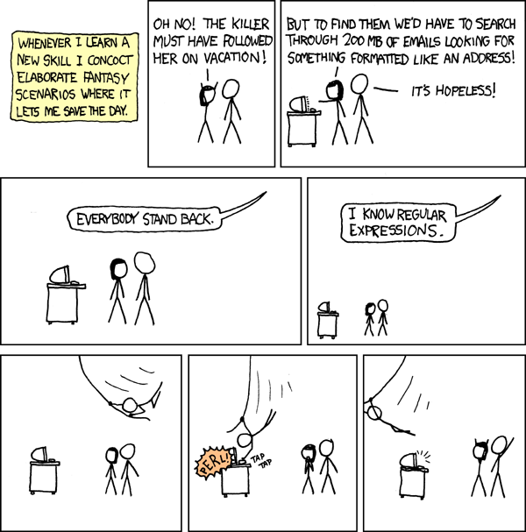
PERL!
You might have heard of it…
“Scripting Language”
Fantastic regex (see =>)
OOP not great
Quite symbol heavy,
many find it ugly to read
(see next slide)
“You may be wondering why it looks like someone ate your keyboard and vomited it onto your monitor.”
- Mark Twain, on Perl

Slide 3
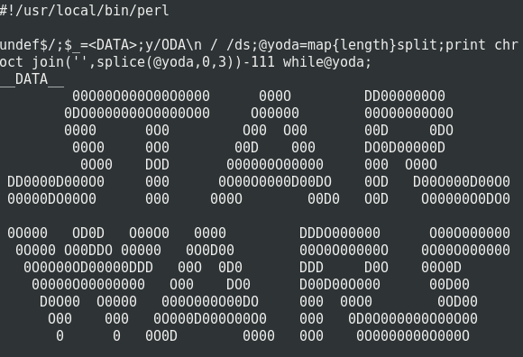
Normal Perl Code
“While many languages can be used to encrypt data, PERL has something built-in that gives you encryption. PERL calls it ‘syntax’”
- Patrick Niedzielski, on Perl
“HEY! I didn’t say that!”
- Patrick Niedzielski, on the previous statement
PERL is based on the write-only programming paradigm. Since it cannot be read, the costs associated with peer reviews, coding standards, and other so-called industry best-practices are completely eliminated.
- Uncyclopedia, the Content-Free Encyclopedia

Slide 4
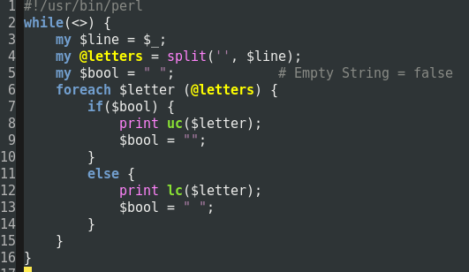
Slightly more boring Perl code
This is how we turned our first email into an abomination artful masterpiece

Slide 5
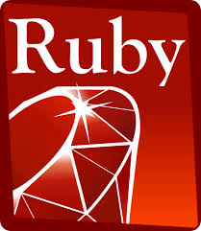
Ruby
Often called “sugar-coated perl”
Looks nicer (to some), functions similarly
Everything is an object
Nice “package manager” (gems)
Ruby on Rails

Slide 6
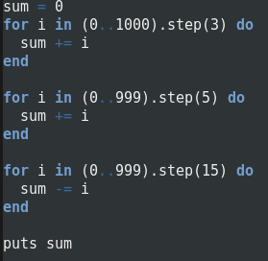
Ruby Example
This solves Project Euler problem 1, which is to find the sum of all multiples of 3 or 5 below 1000

Slide 7
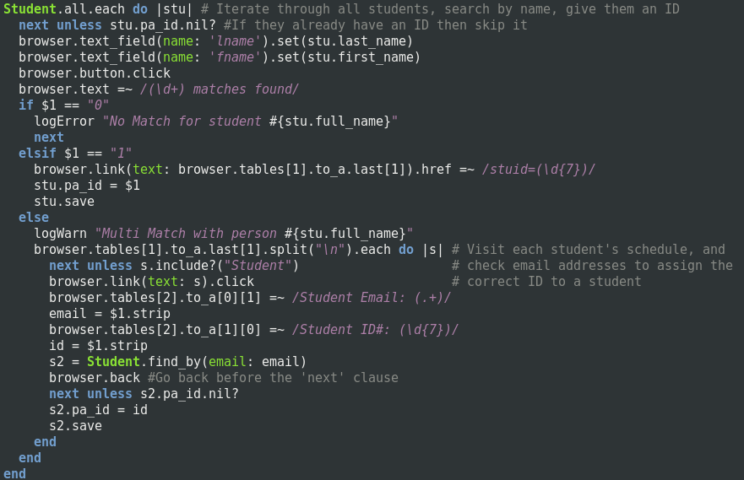

Slide 8

Python
Looks nice and syntax is user-friendly
“Compilable pseudo-code”
Indentation is part of syntax
Some may find this nice; others may want to defenestrate their computer
Most commonly used scripting language
(unfortunately)
“I'd hit it”
~ Dan Aykroyd on having intercourse with a serpent

Slide 9

Java
Sort of interpreted and sort of compiled
Faster than a “standard” interpreted language but slower than something like C++
Strongly focuses on OOP
Code “runs” on all platforms
Detailed analysis of Java’s performance from an encyclopedia:

Slide 10
C++
It’s apparently one better than C!
Similar syntax to Java
However, you can actually control pointers and there’s no garbage collector
Both very good and very bad
It’s compiled, so your programs will run (or crash) super fast
It’s compiled, so it’s harder to run/debug

Slide 11
“The C++ language supports OO programming by providing support for abstraction, encapsulation, inheritance, polymorphism, metamorphism, symbolism, neopaganism, satanism,communism, non-determinism and severe masochism. It gives programmers more control by allowing them to overload and override functions, while being backwards-compatible with the C language ability to overrun buffers.”
-Benjamin Franklin on C++

Slide 12
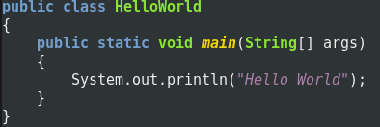
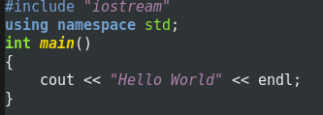
Java and C++

Slide 13
HTML & CSS
HTML & CSS != Programming Languages
Good for what they do, but are markup languages
HTML: learn to love angle brackets
CSS: ironic that it’s supposed to make things look nice…

